Slide 1
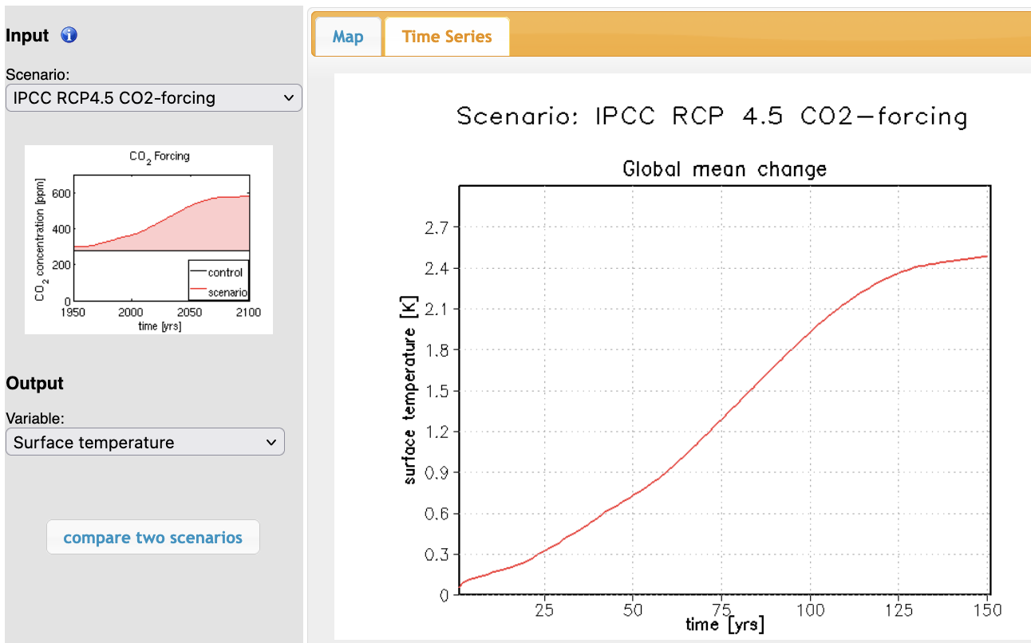
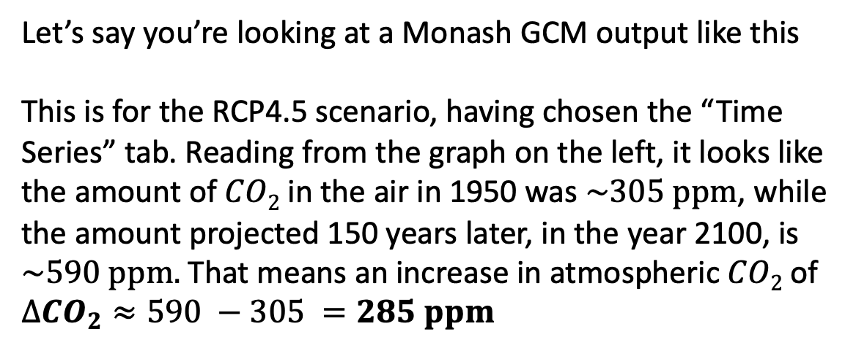
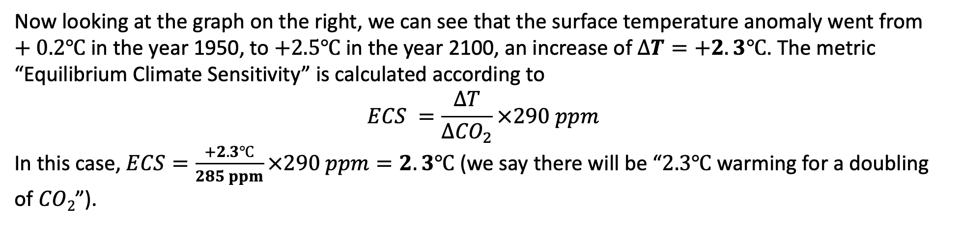
Getting an Equilibrium Climate Sensitivity from a Monash-derived GCM
Let’s say you’re looking at a Monash GCM output like this
This is for the RCP4.5 scenario, having chosen the “Time Series” tab. Reading from the graph on the left, it looks like the amount of $CO2$ in the air in 1950 was $\sim 305 ppm$, while the amount projected 150 years later, in the year 2100, is $\sim 590 ppm.$ That means an increase in atmospheric $CO2$ of $∆{CO}_{2}≈590 −305 =285 ppm$
Now looking at the graph on the right, we can see that the surface temperature anomaly went from $+0.2℃$ in the year 1950, to $+2.5℃$ in the year 2100, an increase of $∆T=+2.3℃$. The metric “Equilibrium Climate Sensitivity” is calculated according to
$$ECS =\frac{∆T}{∆{CO}_{2}}×290 ppm$$
In this case, $ECS=\frac{+2.3℃}{285 ppm}×290 ppm=2.3℃$ (we say there will be “$2.3℃$ warming for a doubling of $CO2$”).

